Slide 1
Chapter 1: Introducing UNIX
CS390: UNIX Programming Beth Allen
Office N317
beth.allen@uah.edu
00 - Course Introduction.pptx

Slide 2
Fundamental Tasks of AN OS
Allocate memory for a program to use
Loads the program image into the allocated memory
Loads CPU registers with control information related to executing the program
Instructions provided by the program are executed on the CPU. OS keeps track of the instruction last executed/to be executed next, enables it to restore a program that may be swapped out of the CPU
If a program needs to access hardware, a call is made to the OS to handle the interaction
After execution, OS cleans up memory, registers no longer needed

Slide 3
UNIX OS
Modern multi-programming OS (multiple programs appear to execute simultaneously by sharing system resources – OS switches between programs)
Written in a high-level language (C) rather than in an assembly language for the machine
Provides a rich set of tools for the user to interact with the OS features
Shell = command interpreter provided for interactive interface
Commands = exist on system as one of hundreds of provided tools, or may be written by you
When you connect to the system via a ssh (secure shell) client, you are assigned a shell at that time.
Our systems default to the bash shell

Slide 4
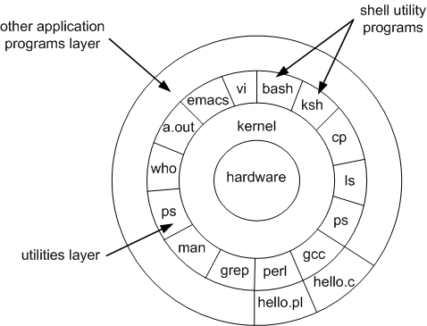
UNIX Architecture: The Kernel
A UNIX System is supported by a handful of simple, abstract concepts
Division of Labor: Kernel and Shell
The kernel is the core of the operating system
Loaded into memory by a bootstrap program when system powered on
Comprises a set of routines that communicate with the hardware directly (system calls)
Manages memory
Schedules processes
Decides process priority
Manages storage system(s)
One copy residing in memory, shared by all users

Slide 5
UNIX Architecture: The Shell
The shell is a program that provides the user with an interface to the kernel
One kernel / many shell processes
A program or command that is started only when the user logs in
A shell is an interpreter that accepts user input
Examines the input
Rebuilds the input into a command
At least one shell is invoked by every user
User has choice of shells
Makes calls to the kernel

Slide 6
UNIX Features
Multiuser System
Time-sharing: principle by which a multi-programming system simulates concurrent operations by sharing the system based on time intervals
Switches between user processes so quickly that it is responsive and fair
Repository of Applications
Kernel = UNIX, but by itself it isn’t very useful by itself
UNIX has a host of common utilities such as text manipulation, process management, file system utilities, compilers, interpreters and networking applications
Building Block approach:
Complex tasks are performed by executing a series of simple tasks in sequence
Powerful pattern matching features can be used to configure data for these tasks

Slide 7
The File and Process
Two simple entities that support UNIX:
“Files have places and processes have life”
Files are containers for storing information
Even directories and devices are considered files
Files are related by hierarchical structure called the file system
Processes represents a program in execution
Also form a hierarchy

Slide 8
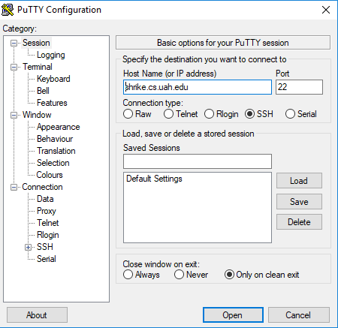
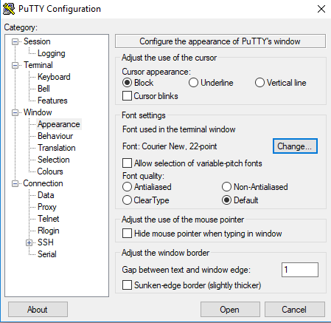
Demo
Demonstrate Remote Login Using PuTTY
PLEASE – set your font to at least 20 to 24 if you need me to help debug something on your computer!
Appearance

Slide 9
Ch. 1: Review
Run ps command and note the PID of your shell. Log out and Login again and run ps again. What do you observe?
Why do UNIX tools perform simple tasks rather than complex ones?
Run the following commands and then invoke ls. What do you conclude?
echo > README
echo > readme
What is the one thing that is common to directories, devices, terminals and printers?
You can use passwd on the Linux machines to change your CS account password.

Slide 10
- END -

